Slide 1

WIDS DATATHON 2020

Slide 2
PROBLEM STATEMENT
THE CHALLENGE IS TO CREATE A MODEL THAT USES DATA FROM THE FIRST 24 HOURS OF INTENSIVE CARE TO PREDICT PATIENTS SURVIVAL.

Slide 3
TYPE OF THE DATA SET &SIZE OF THE DATA SET
The type of data set we are considering is Training data set .
Training data set in Machine learning is used to create a model .
This data set helps to reach the ultimate goal of predicting the results
SIZE OF THE DATA SET : The given data set contains of 186 rows and 186 columns

Slide 4
DATA UNDERSTANDING
The Datathon has already provided us a data from more than 1,30,000 hospitals.
All the information is from intensive care unit visits from patients spanning a one year time frame.
The data provided is from different parts of the world like Argentina, Sri Lanka, New Zealand, Brazil and more than 200 hospitals in US.

Slide 5
Our data set contains 186 rows and 186 columns containing patient details and his/her medical history .
In this 186 rows we are going to choose the details which we will be using in development to the module to determine the survival of the patient.
The plan is to consider the details about his health like height, weight, white blood cells, glucose content, creatinine content ,heart rate etc.
We are in thought of choosing 30 – 40 rows among the 186 rows and considering all the columns.

Slide 6
MODELS USED:
Linear regression
Random Forest
XGBoost

Slide 7
Linear Regression:
Regression models a target prediction value based on independent variables.
So, this regression technique finds out a linear relationship between x (input) and y(output). Hence, the name is Linear Regression.
Linear Regression always gives us minimum accuracy.
We acquired an accuracy of 25 %.

Slide 8
Random Forest:
Random forest is a Supervised Machine Learning Algorithm that is used widely in Classification and Regression problems.
One of the most important features of the Random Forest Algorithm is that it can handle the data set containing continuous variables.
Using Random Forest Algorithm the accuracy we obtained is 92 %.

Slide 9
XGBoost:
XGBoost provides parallel tree boosting and is the leading machine learning library for regression, classification and ranking problems.
XGBoost is efficient implementation of gradient boosting that can be used for regression predictive modeling.
We acquired an accuracy of 93 %.

Slide 10
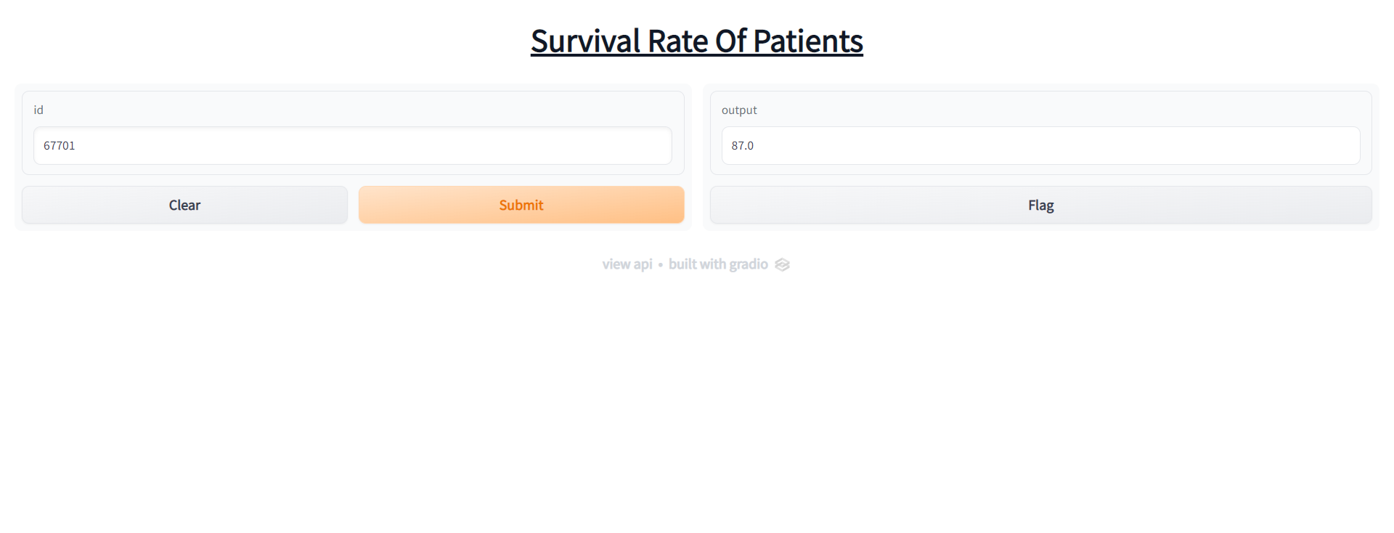
Output:

Slide 11
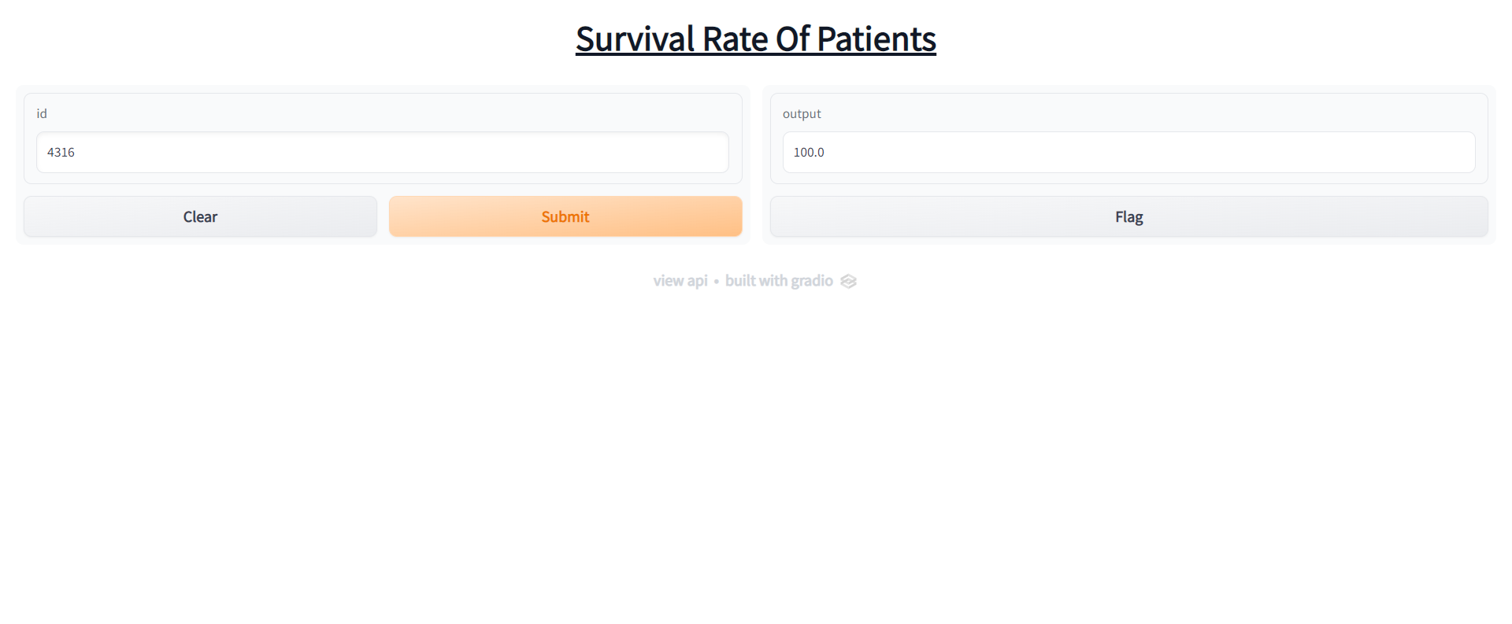
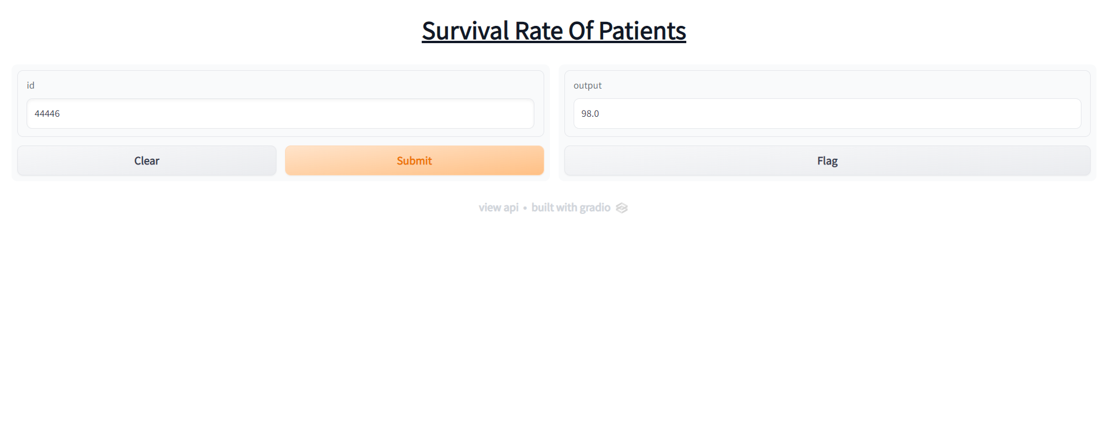

Slide 12
THANK YOU

